Slide 1

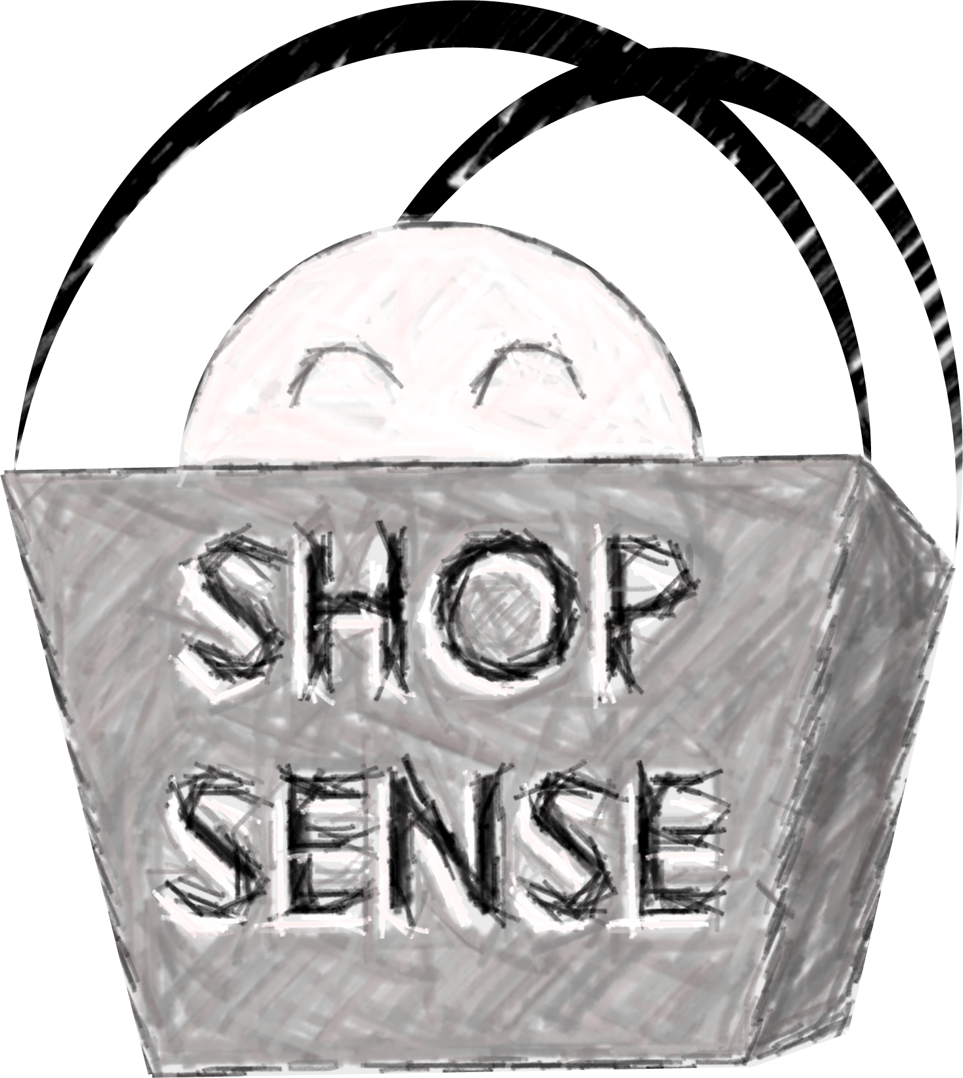
UX/UI Project 1
Evan Ingersoll
Julie Nguyen
Zach Thomas

Slide 2

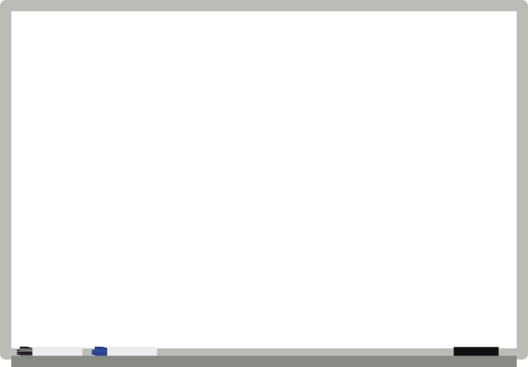
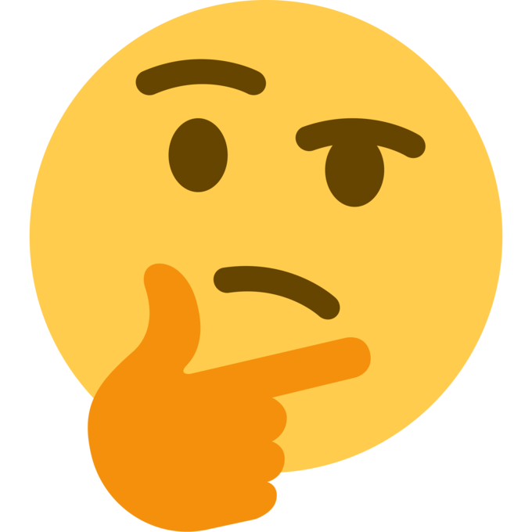
What is ShopSense?

Slide 3
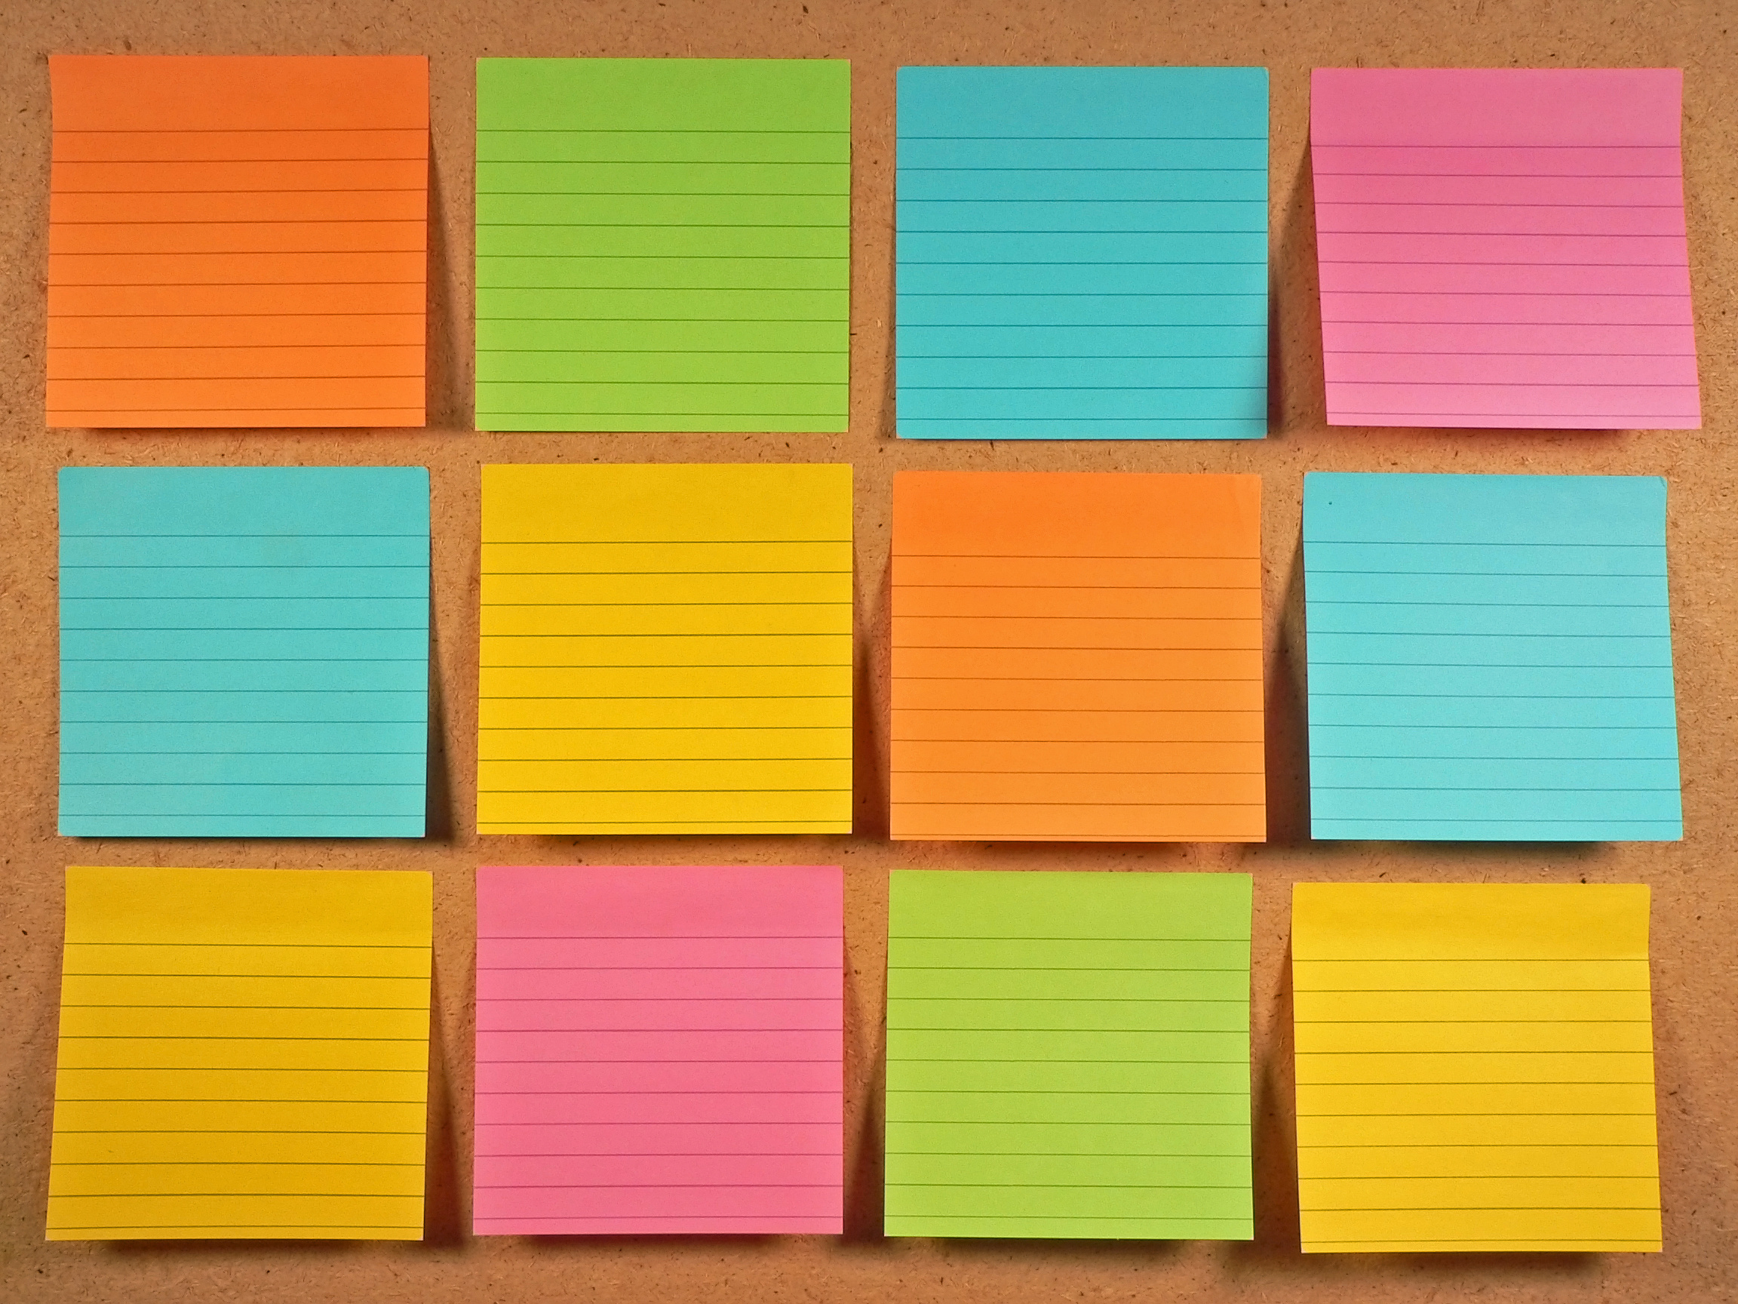
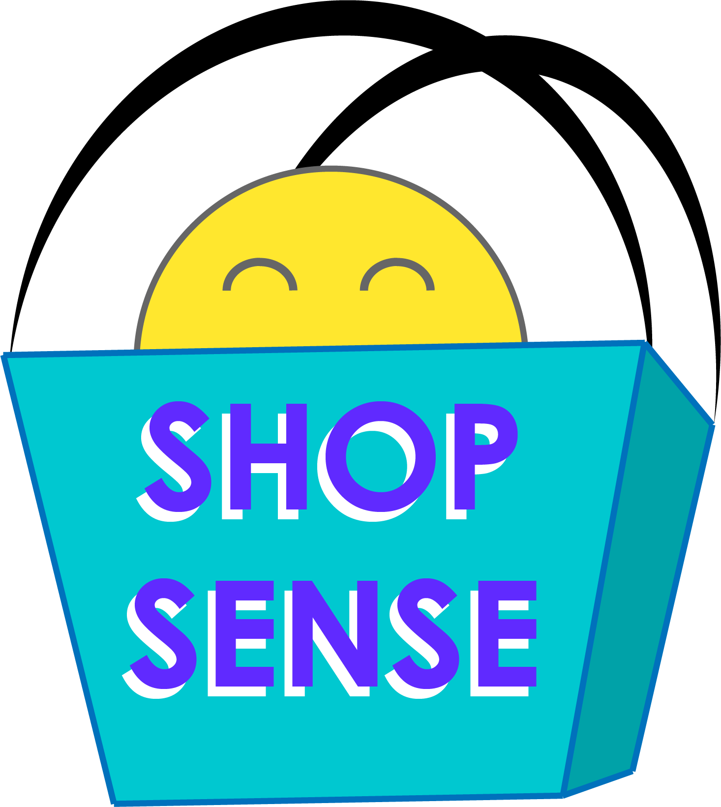
Has filters to breakdown collective mall inventory by: type, price range, sizes & color.
Database & directory of all the clothing stores in the mall.
User can “favorite” certain items to return to later.
Based on purchasing history & “favorited” items- the app can give you store or clothing suggestions.
Allows store employees to locate what you need ahead of time, and have it reserved for you to check-out.
Allows user to “cross-compare” stores w/o having to pull up each, individual website.
Cuts down on the time user spends at the mall/stores by being able to find and buy needed items.
Businesses can see what people have been buying/”favorite”-ing in order to purchase more of these more popular items in the future.
Can make for better business as customers are directed straight to them/know all that they have to offer in their inventory.
Happy, less frustrated customers+ streamlined buying process = increased likelihood they will purchase from the store again.
Allows user to see which stores are currently open and their working hours.

Slide 4
user focus:
Who can use it?
Everyone- of all ages, backgrounds, income, etc.
Can be used at any mall with retail/clothing stores.
We chose Barton Creek Square Mall for the variety of stores, age groups, price range, and proximity.

Slide 5
Problem Statement:
Sarah Banks has observed that shopping at the mall isn’t meeting her time/efficiency needs, which is causing her undue stress and apathy towards shopping at the mall. How might we improve her shopping experience so that it is more successful based on her time and quality constraints?

Slide 6
The Proto-Persona

Slide 7
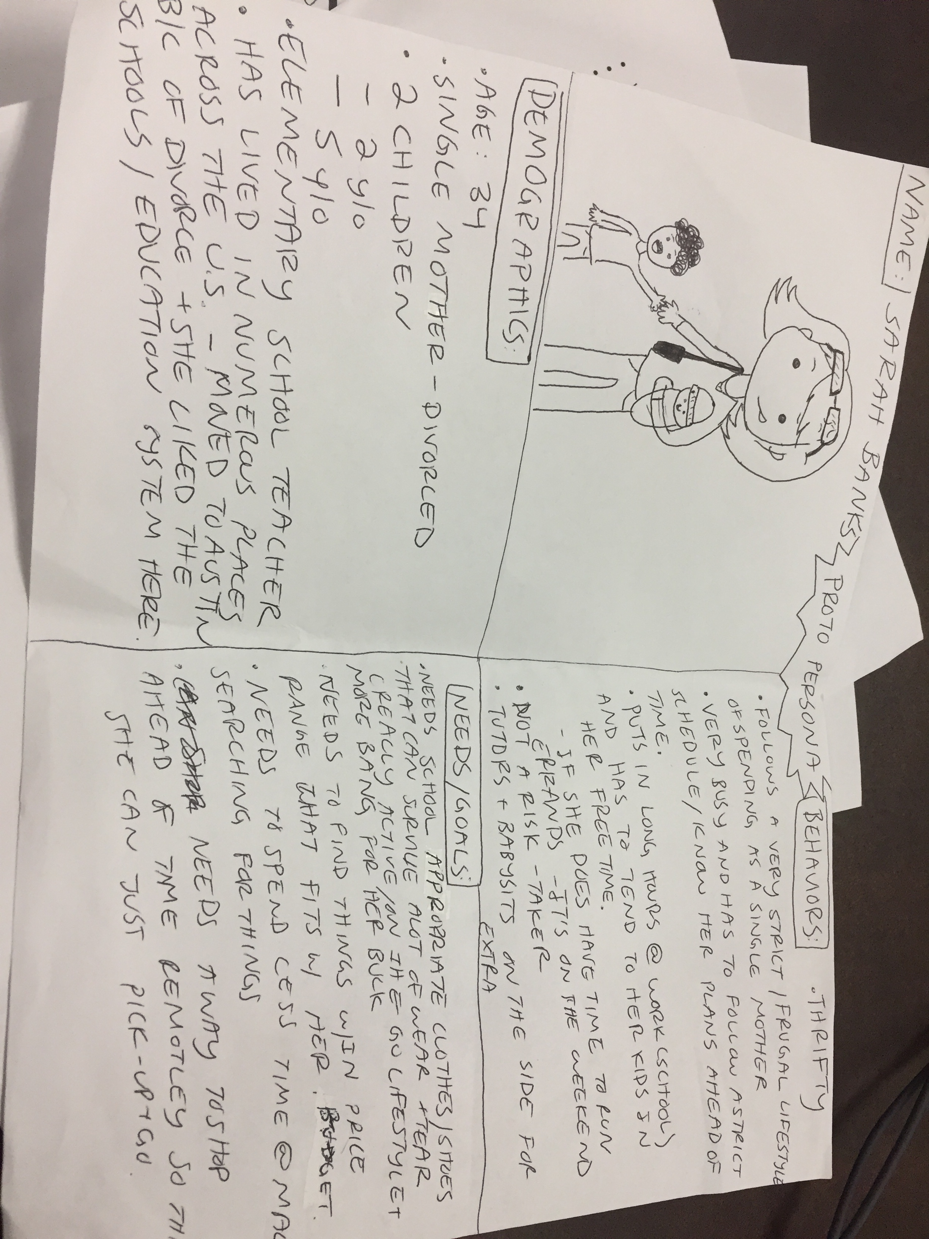

Slide 8
The Interview Process

Slide 9
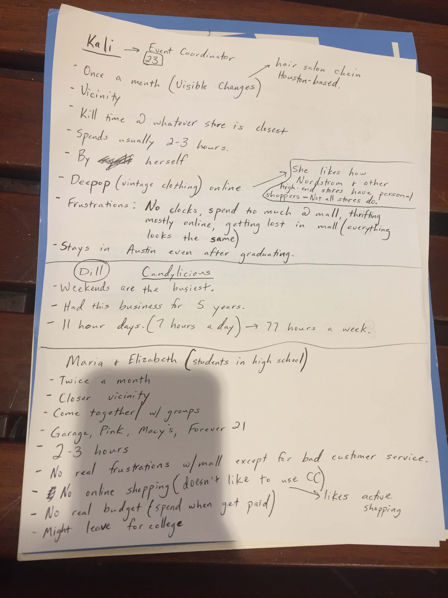
Where are you from originally and how long have you been living in Austin?
How old are you?
Can you describe a typical day for you?
Do you usually go shopping alone or with people (ask them to describe who they go with?)
How often do you come to Barton Creek Mall?
How familiar are you with the layout of this mall?
Do you come here for “fun”/to hang out or do you only come if you need something in particular? Why?
Are there certain times of the day or week that’d you rather come?
Are there certain stores you definitely go to or are you open to going to many?
On average, how long do you stay at BCM for?
Are you currently in school studying something or working anywhere?
How did you hear about BCM?
What were the events or thoughts that made you go to BCM over other malls?
Is there anything else you like to do in your free time (Ex. hobbies)?
Is there anything that frustrates you about BCM and is something they could improve on?
What’s something that BCM doesn’t have now that you think shoppers could benefit from?
Answering honestly, would you use an app that had a directory of all the clothing stores (including inventory) to where you could input your budget, size, and other filters so that you could compare stores? Would that cut down on your time there?
Employees: would this be beneficial to businesses?
How often do you online shop?
Would you say that you are confident wearing particular “styles” or types of clothing or do would you like more help, in general, picking things out to wear for right occasions.
Does your occupation restrict you to wearing certain things/not wearing certain things?
What are you currently doing to make shopping for clothes easier?
How does shopping at the mall impact other areas of your life/work?

Slide 10

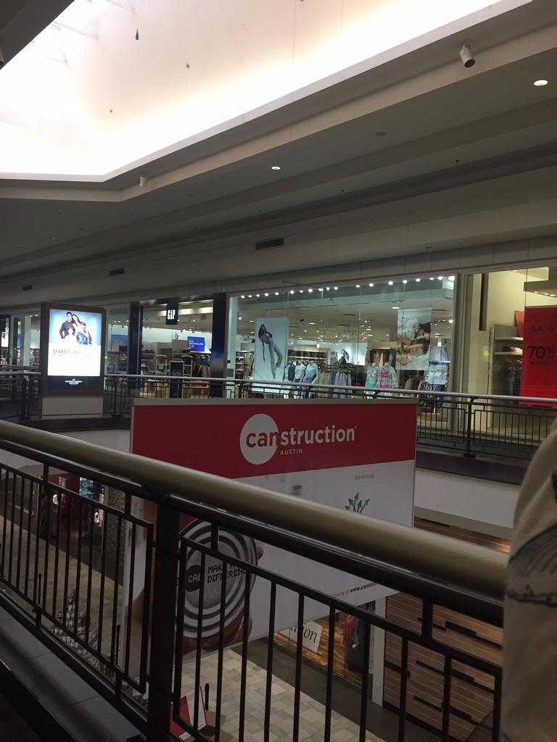
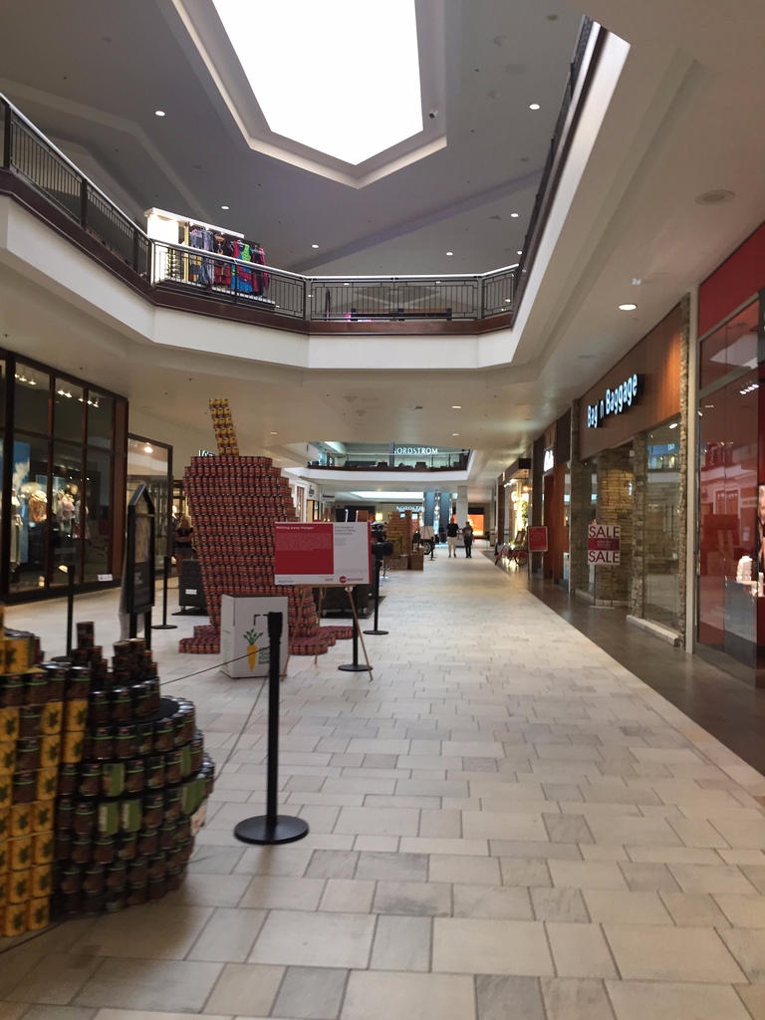

Slide 11

Empathy Map

Slide 12
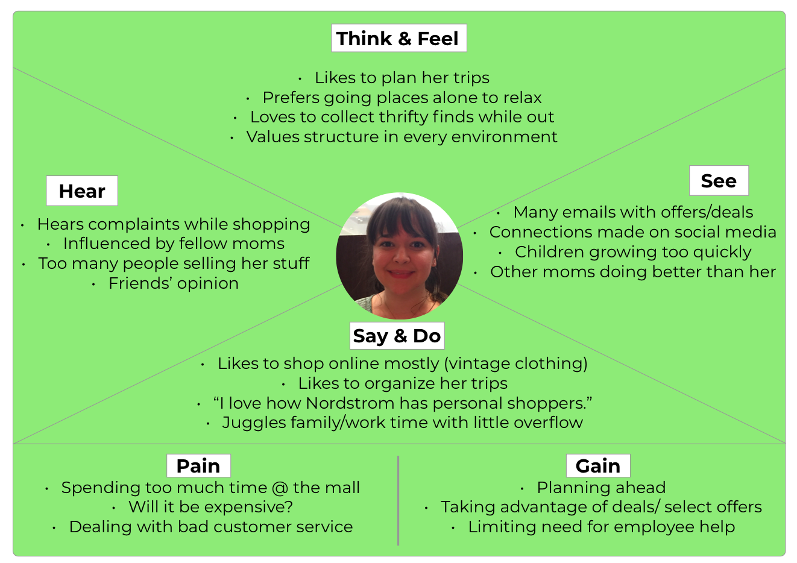

Slide 13
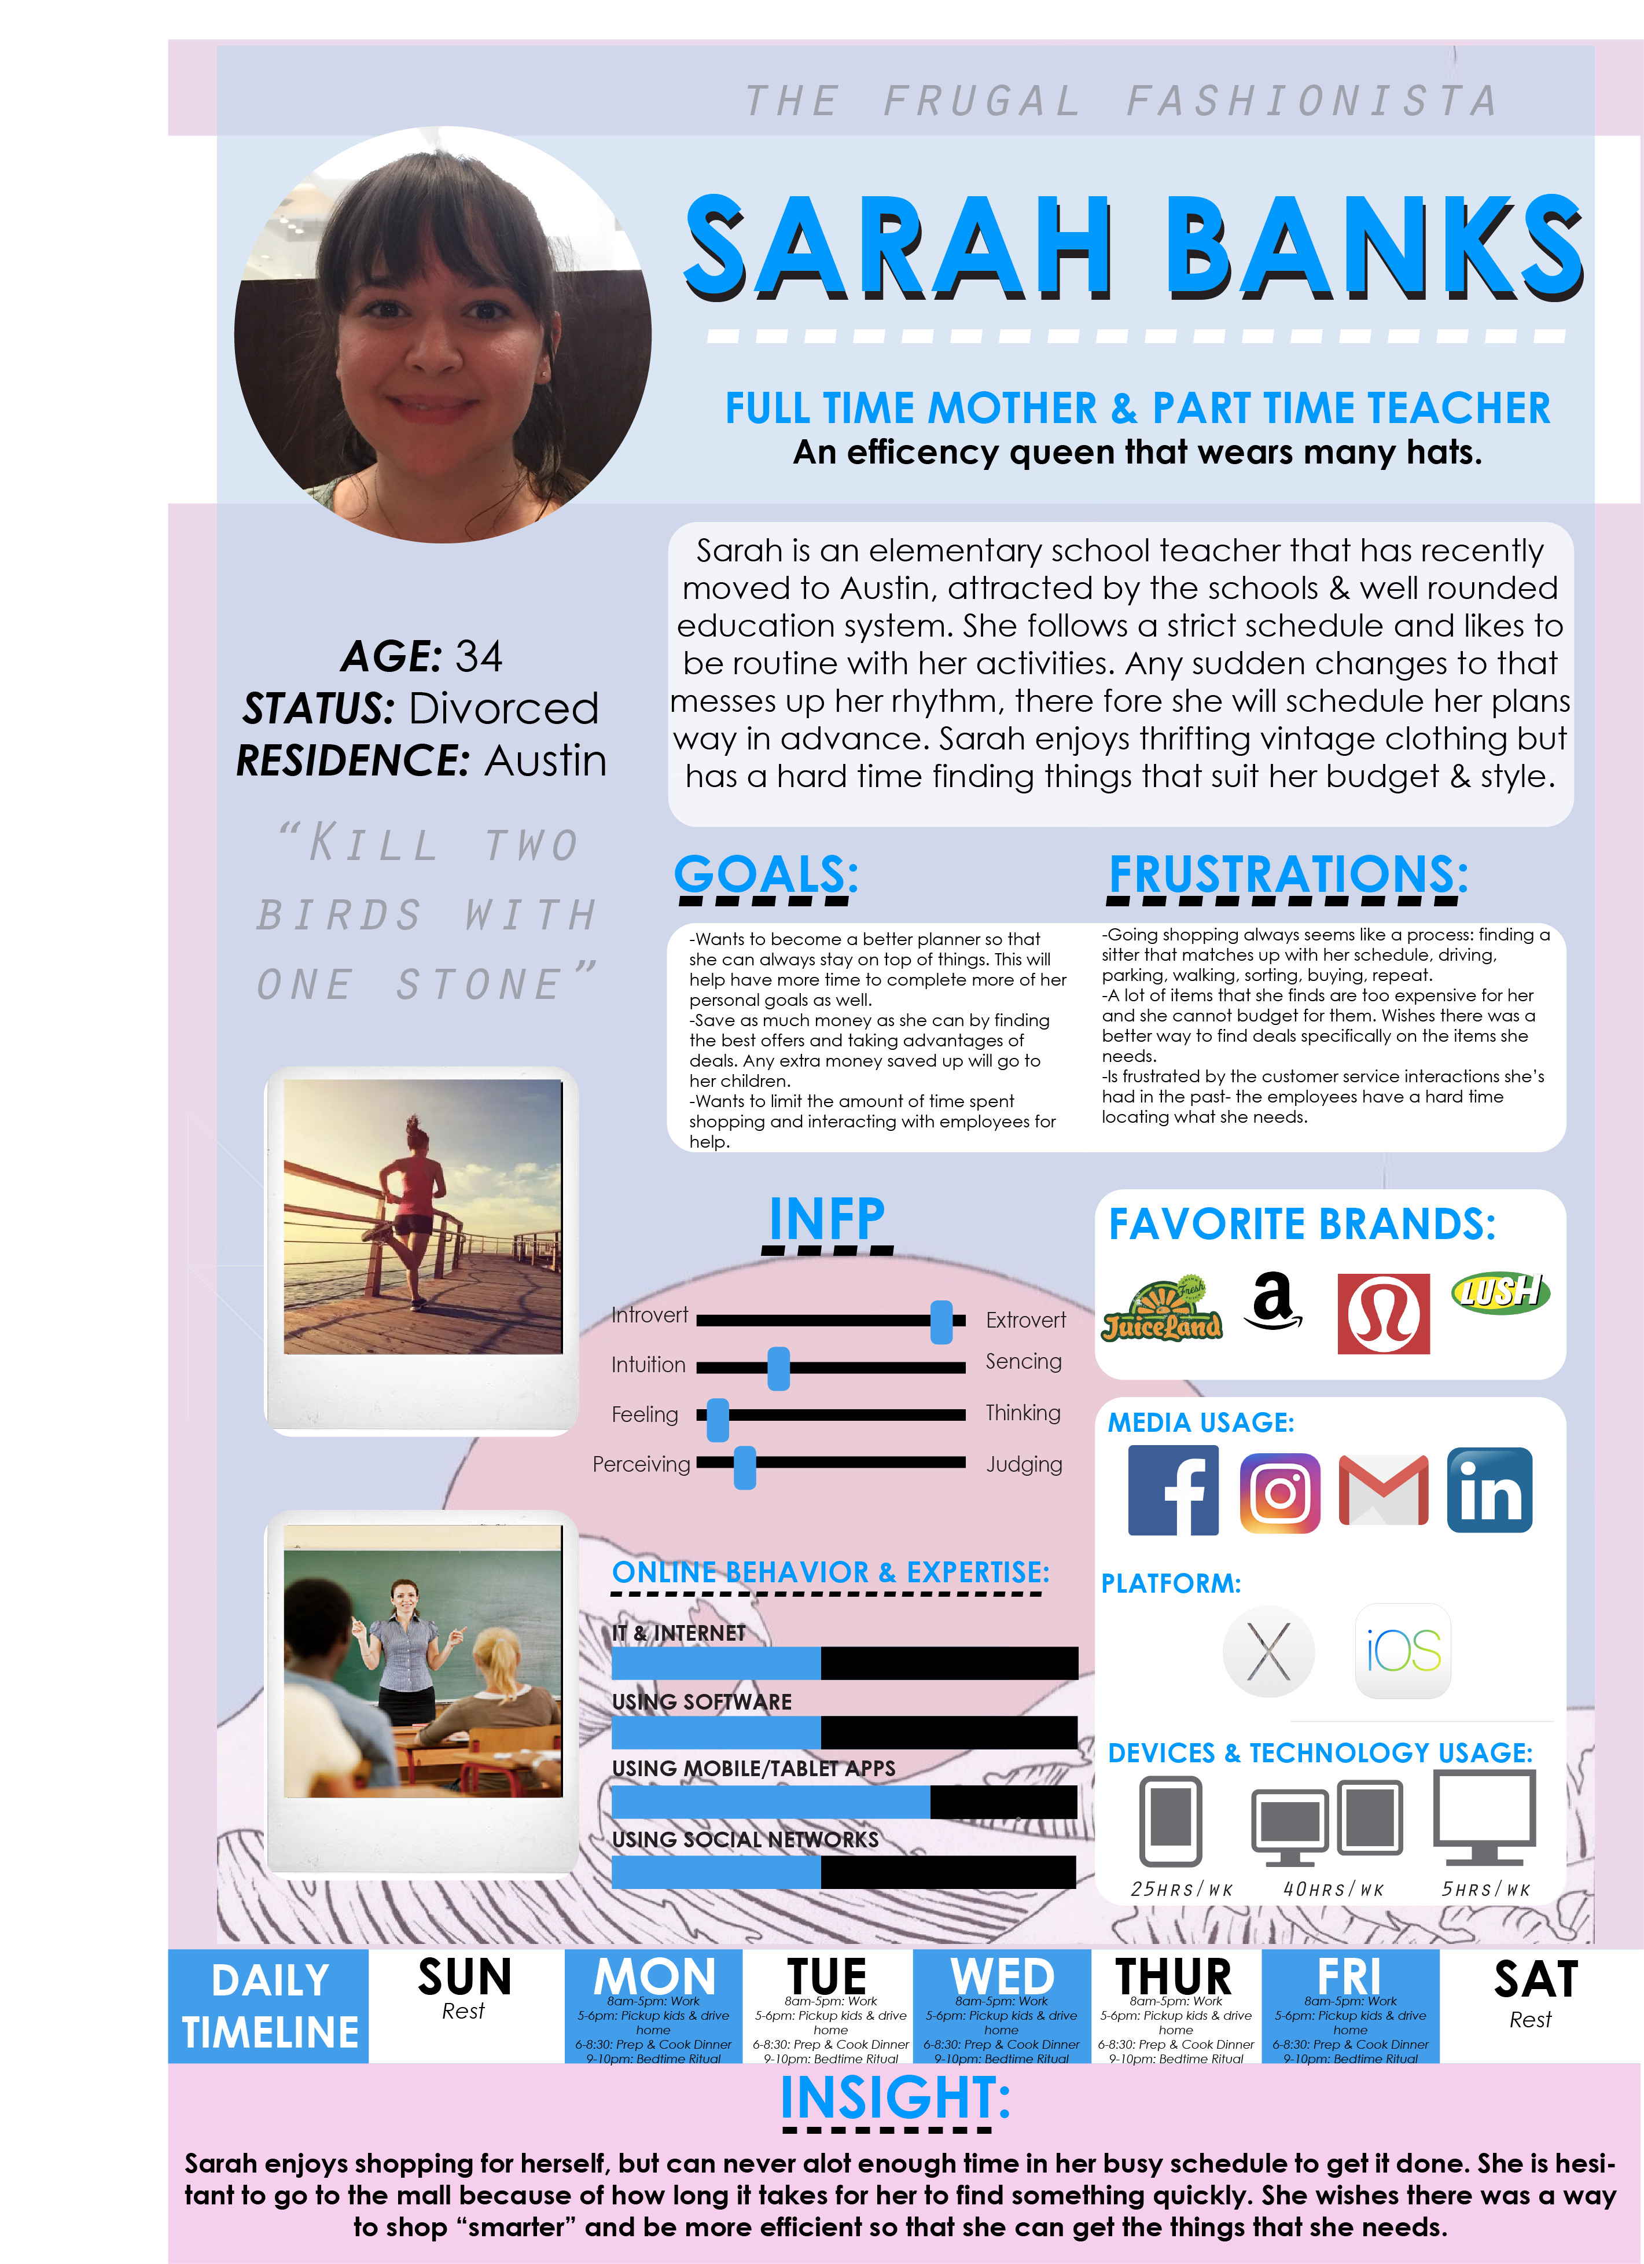
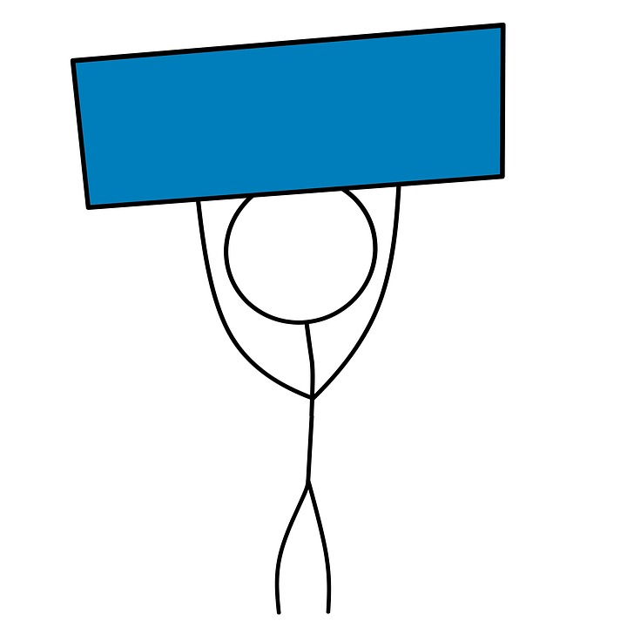
User
Persona

Slide 14
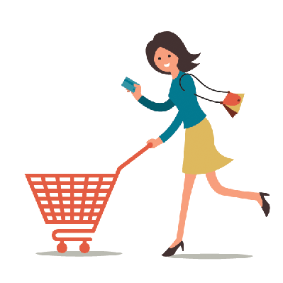
Sarah spends much of her Saturday morning contemplating taking her two children with her to the mall to buy new clothes for the family. She decides to get a babysitter so she can go alone to search for the necessities. At the mall, she faces different challenges that keep her from her goal of buying only what her family needs. The crowded spaces in the mall, overpriced items, not being able to find the correct sizes, and taking too much time away from her kids are all factors that give her anxiety throughout the whole process.
UX Scenario

Slide 15
Storyboards

Slide 16
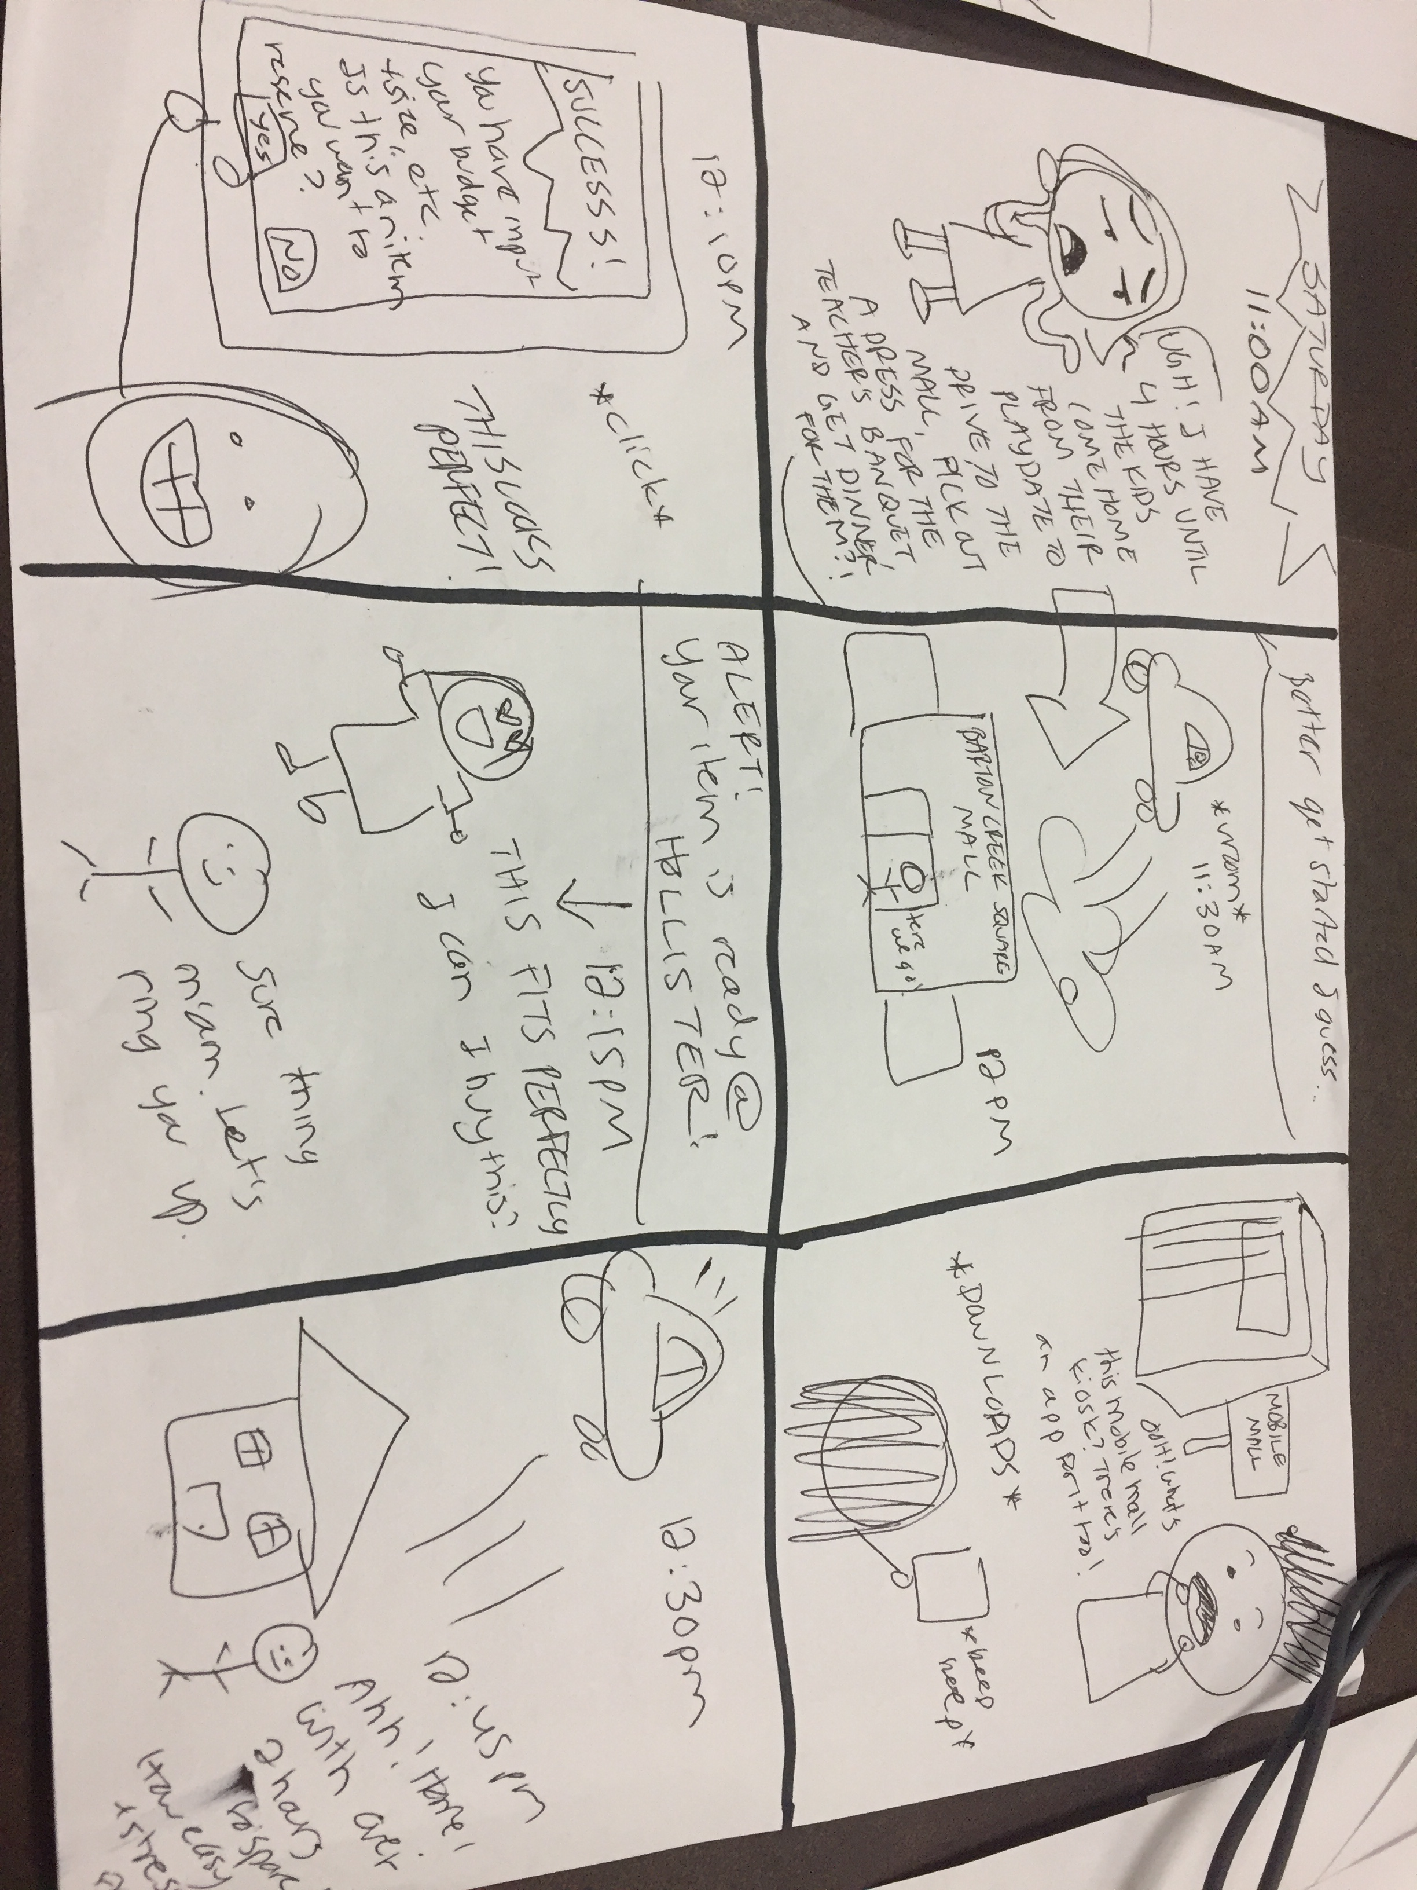

Slide 17
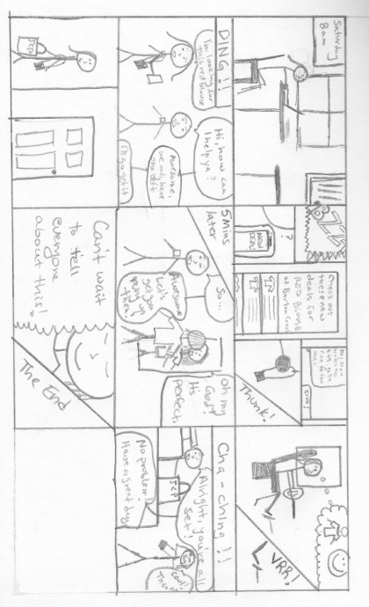

Slide 18
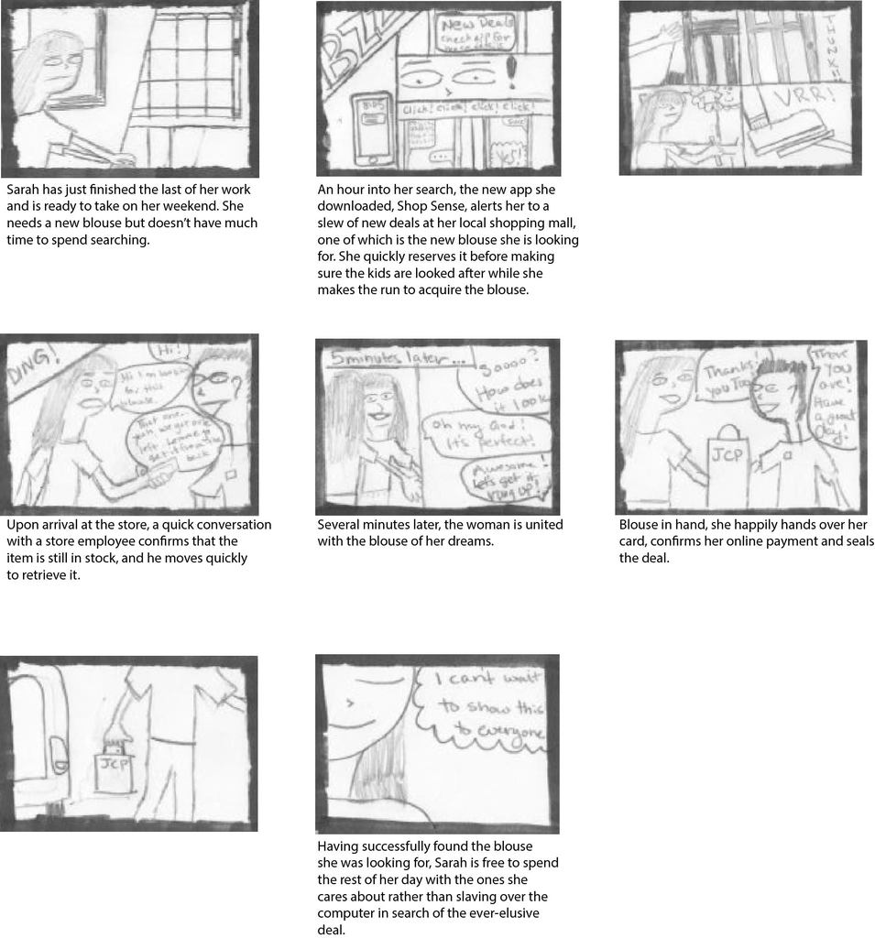

Slide 19
decision
flows

Slide 20
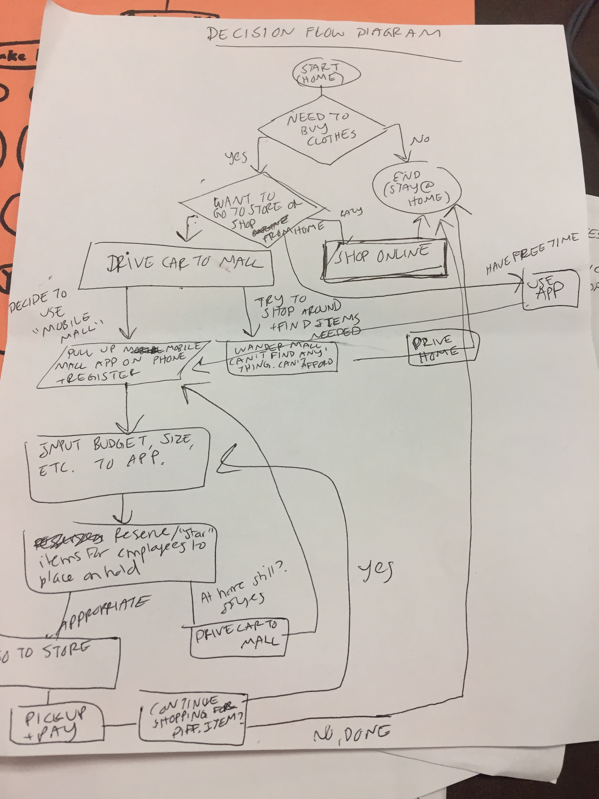
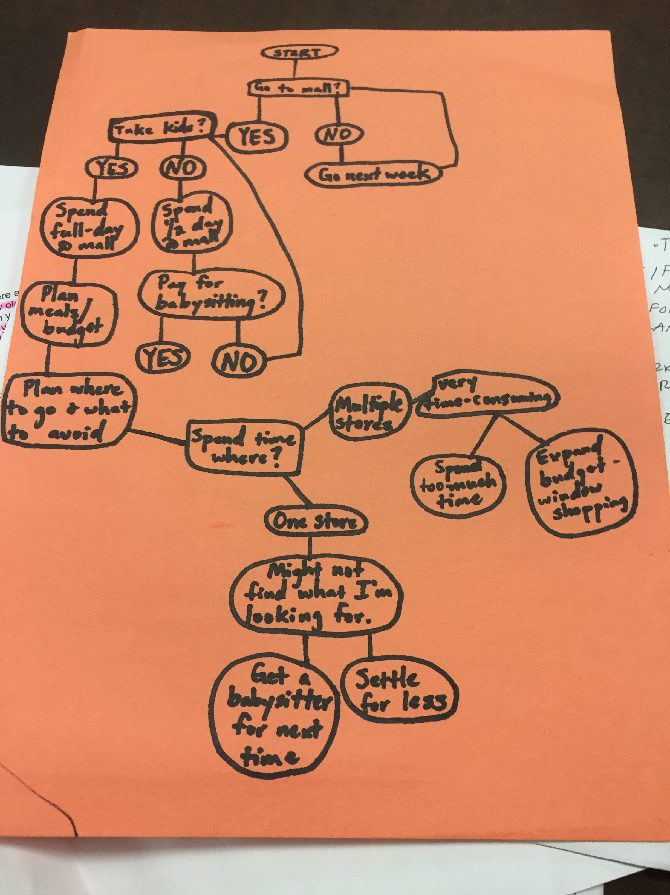

Slide 21
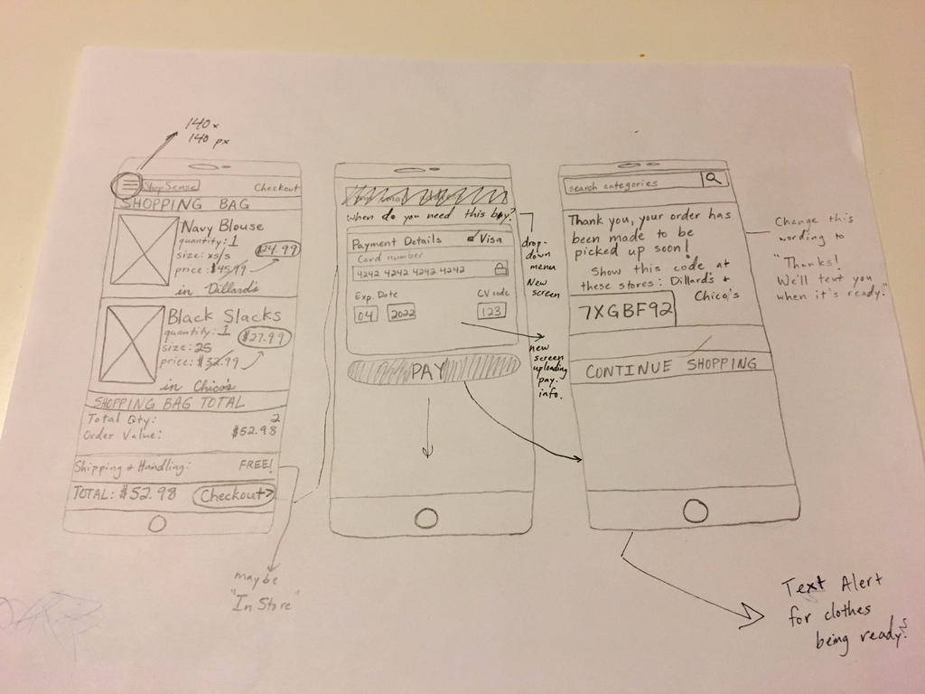
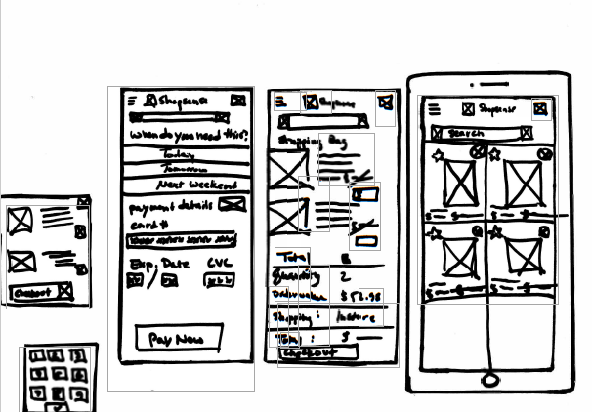
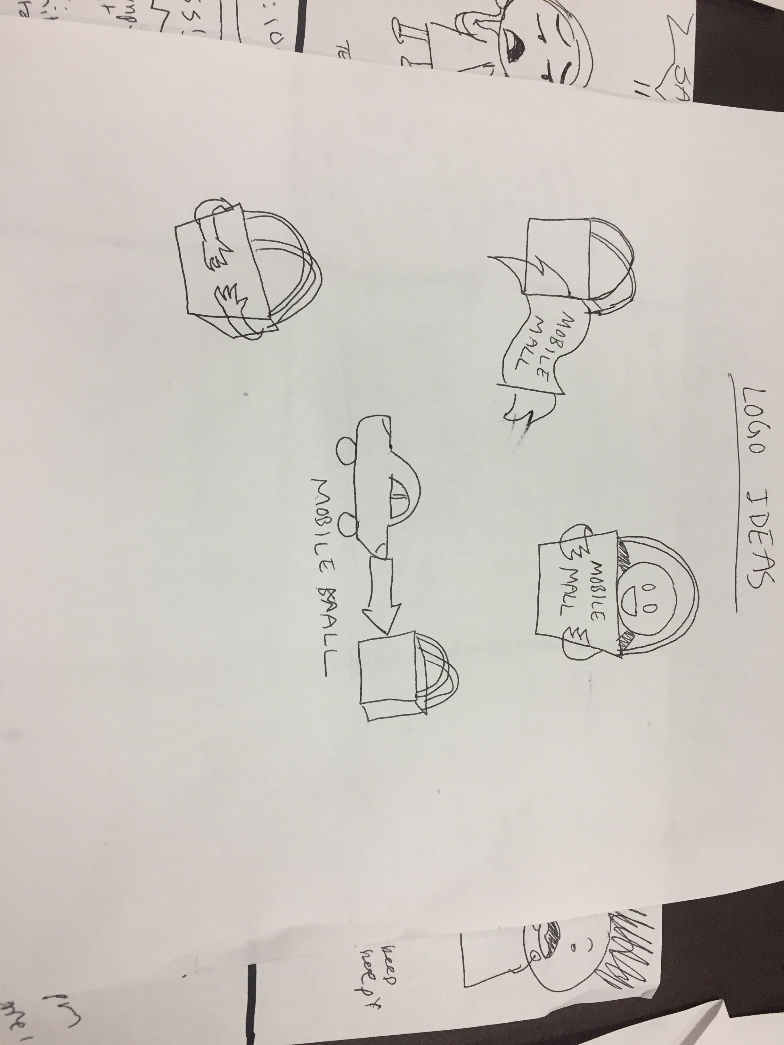
Paper Sketching & Prototyping

Slide 22
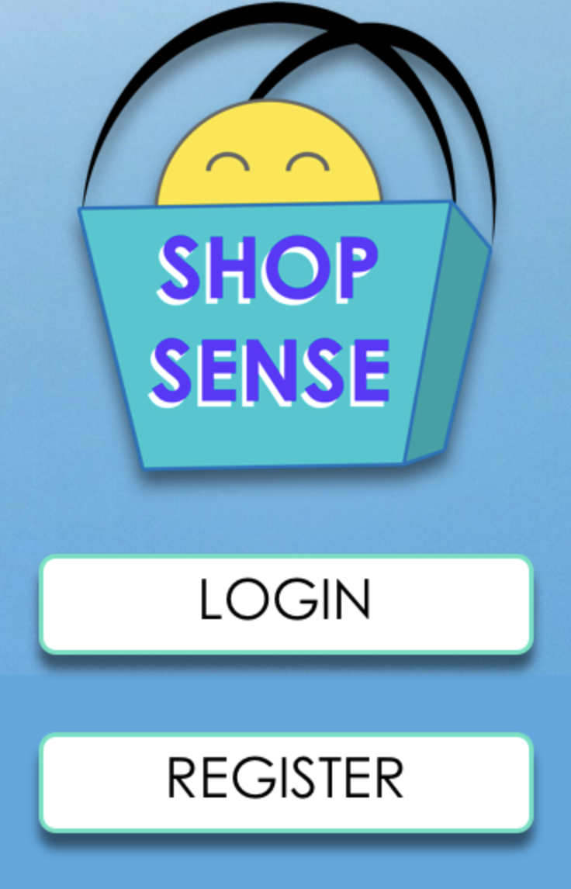
Invision App Demo
https://invis.io/Q4INBQVHDE9

Slide 23
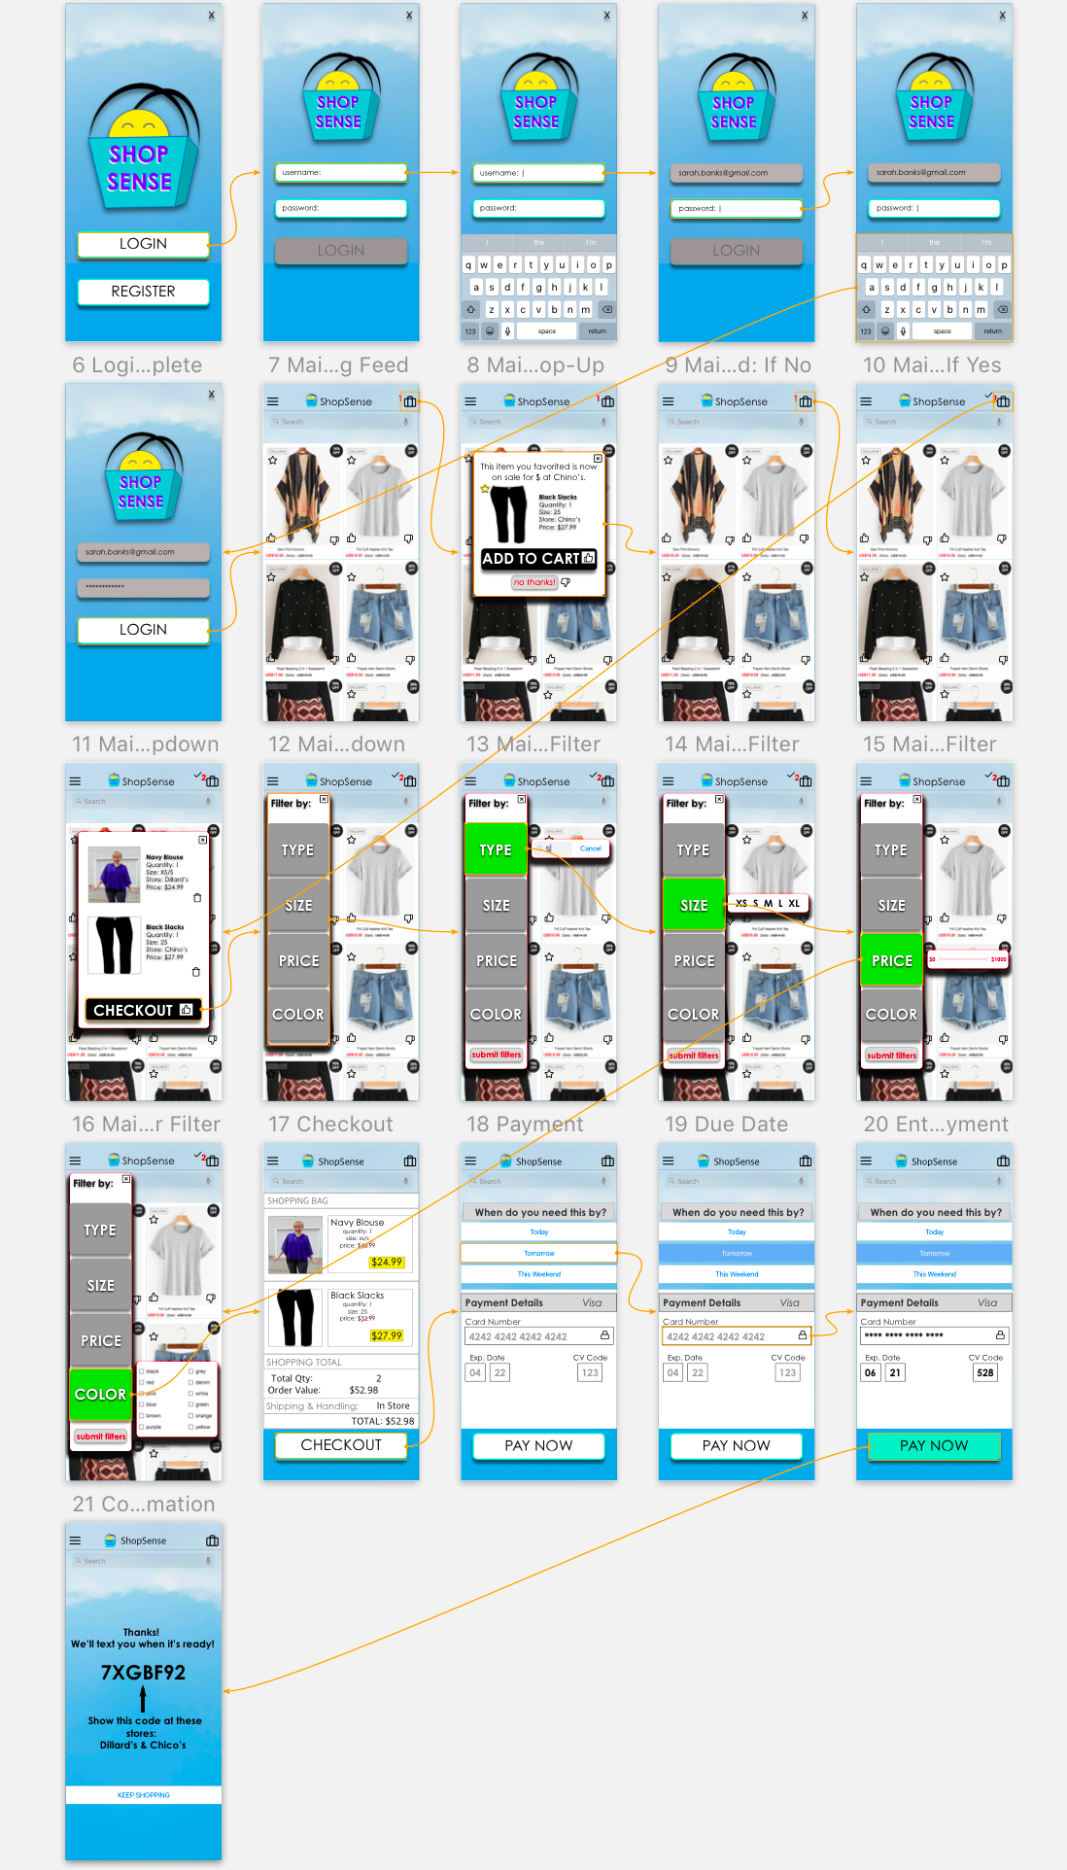
>> user flow

Slide 24
Directions for Future Development:
Add more filters such as : brand, style (ex. vintage, preppy, modern)
Add a way for users to rate items they have purchase & stores.
Can display the highest rated items first.
Implement a program that continuously updates the inventory in real-time (as people are “reserving”), rather than depend on employees to manually input items.
Creates a “digital” receipt for the user (useful for lost receipts and cutting down on paper costs).
Partnership w/ businesses to feature their store items first, given the user’s search input.

